Slide 1


Taking “Age” Out of Intergenerational Programs: A New Model for Connecting Older and Younger Adults in Classrooms and Communities
Joann M.Montepare
Director, RoseMary B. Fuss Center for Research on Aging and Intergenerational Studies

Slide 2
Abstract
A search of the literature on intergenerational programs reveals that the majority of programming involves young children and older adults. In cases where programs involve young adults, the focus is often on benefits to college students for changing beliefs about aging with no mention of potential benefits to older adults. Moreover, these cases are often specific to gerontology-related course settings which focus on issues of aging. As such, young adults’ exposure to older adults is relatively narrow and limited in scope. And, the older adults’ role is often as a target of interest rather than as a collaborating partner in the teaching and learning process. In our aging and increasingly age-segregated society there is not only a need for a greater recognition of age diversity, but also a need for younger workers with age awareness as well as a need for older adults to stay engaged in order to maintain high levels of well-being and promote successful aging. How might this happen? We propose a new model for intergenerational exchange which utilizes programming around “non-age focused” issues of mutual interest for older and younger adults. Our lifespan education model stems from the premise that intergenerational exchanges in the classroom and in the community which focus on individual interests, strengths, and experiences of older and younger adults have a greater facilitative effect in reducing age prejudice and nourishing engagement than do more commonly designed programs built around issues of aging. In the long run, we hope that this model will inspire and generate new programming in and out of the classroom which will reduce age-segregation and help to support growing needs in our increasing age diversified society. In this symposium presenters will share best practices for developing successful “de-aged focused” programs involving college students and older adults in the classroom and the community. Specifically, we will discuss ways to identify program topics across the curriculum, the use of alternative multi-generational strategies, and challenges and solutions involving logistics within a contemporary framework of shifting age demographics. We believe that the scope and quality of intergenerational exchanges will have greater reach and impact with attention to this new way of thinking about programming.

Slide 3

Age Demographics are shifting Education needs are changing
Notes:
I’d like to begin by noting that the age demographics are changing swiftly and dramatically (no surprise to any of us), and these changes have wide and deep implications on many fronts. However, this is certainly a case of “speaking to the choir”, that’s why we are all here at AGHE
Along with changing age demographics we all also know that educational needs changing on a number of fronts. For example, 1) there is a need more than ever to introduce students to issues of aging as they prepare for their personal and professional adult lives, 2) there is a need to focus on older learners who are connecting with our classrooms and institutions in new ways (which we will hear more about today), and 3) there is a need to connect the aging-related work that goes on our classrooms with our communities more broadly – as this is where much of “aging occurs“

Slide 4
Session overview
“Talk of Ages” - A Common Ground Approach to Intergenerational Teaching and Learning
Joann M. Montepare (Lasell College)
W.I.S.E. - Working together: Intergenerational Student/Senior Exchange
Carrie Andreoletti (Central Connecticut State University)
Jennifer Leszczynski (Eastern Connecticut State University)
Linking Undergraduate Students with Grandfamilies to Support Intergenerational Relationships
Christine A. Fruhauf (Colorado State University)
Discussant
Anne Barrett (Florida State University)
Notes:
In our session today, we’d like to share with you how we have been addressing changing educational needs on our diverse programs, and some of the things we’ve learned which we believe is important for us all to examine more closely as we continue to broaden and build educational programs to address changing demographics and their implications. One basic issue you’ll hear about in our talks is how we’ve started moving away from bringing together younger and older adults around issues of aging as a way for students to learn more “about aging”. In my comments I’ll talk for a bit about why this has worked against broadening and appreciation and understanding of aging.

Slide 5
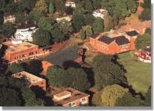
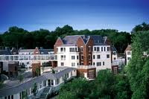
Lasell College
Founded in 1851, Newton, Massachusetts
1600 undergraduates in professional studies within a liberal arts curriculum
Lasell Village
CCRC established in 2000 at Lasell College
250 residents complete a personalized learning plan of 450 hours per year as condition of residency
Notes:
To get us started, let me tell you about my college and aging program. I’m at Lasell College, which is a small liberal arts College just outside of Boston. For many years it was a 2 year women’s college. In 1992 I became a 4 year college, in 1998 it became a co-educational college, and in 2000 it became an intergenerational campus. In 2000, it build Lasell Village, a continued care retirement community on the Lasell campus – “down the street from the campus center”. While it is in many ways it’s a typical CCRC – it has a one distinctive component. DESCRIBE EDUCATION COMPONENT.

Slide 6
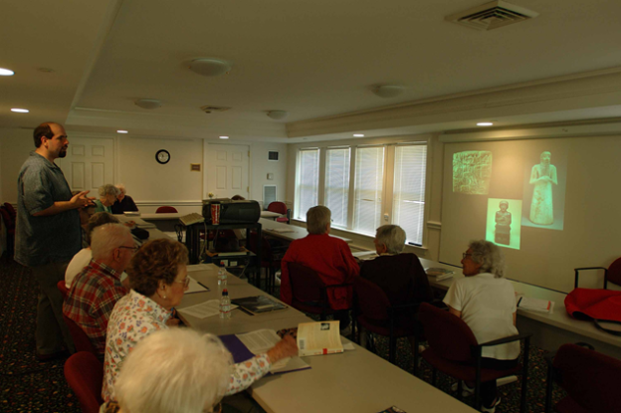
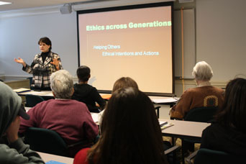
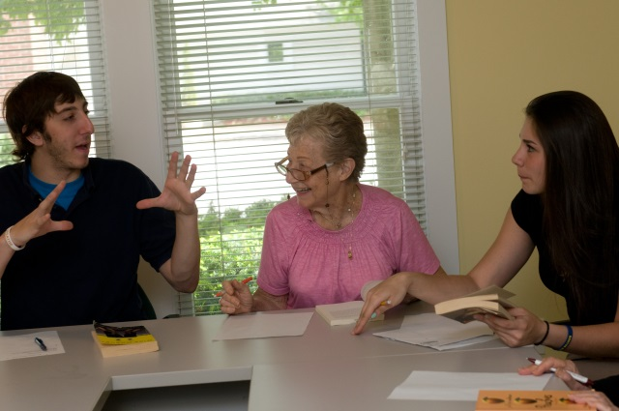
Lasell Village Residents
Average age ~ 86 years
Age range ~ 75 – 101 years
Educational Background
High school - BA degree or equivalent = 59%
MA, PHD, MD, JD, advanced degrees = 41%
Average resident participation is 500+ hours per year
Notes:
Describe the resident population

Slide 7
Teaching and Learning formats
Village Classes
College Classes
Intergenerational Classes
Intergenerational Projects
Notes:
Residents may fulfill their education requirements in a number of ways.
Residents can take 4 – 8 week classes at the Village with other residents.
Residents can take any class at the college.
In addition, residents can take a designated intergenerational class, such as my classes which deals with adult development and aging.
Residents can participate in special age-related intergenerational class projects -- such as the class in Ethics and Morality in War Literature which produces a book of interviews with older veterans about their experience during WWII, Korean War.

Slide 8

Notes:
In the first few years, classes in which younger and older students came together were very popular.

Slide 9

Notes:
However, over time there appears to have been a “natural decline” in intergenerational engagement.

Slide 10
Challenges
Not many students want to know about aging
Many residents know about aging
Students are vocation oriented
Residents are avocation oriented
Students and residents have busy schedules
Faculty lack support and resources
Notes:
What might account for the decline in intergenerational engagement? It’s been my observation that factors are at work. DESCRIBE THESE FACTORS.
In speaking other colleagues, its become clear that these issues are not unique to my institution – and, we can see them at work in other programs trying to bring together younger and older learners in intergenerational exchange.

Slide 11
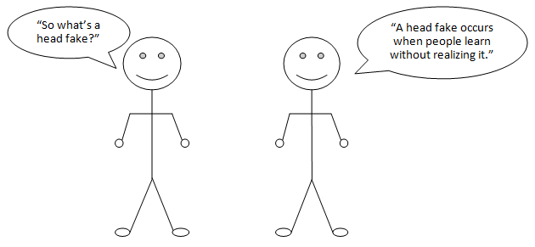
The new no age approach
Notes:
So, what can we do about it? One solution that I’ve been exploring (and my other colleagues here today have been considering) – is to revise the basic framework around intergenerational exchange.
The basic idea is that in order to bring older and younger learners together, a more “common ground” approach is needed which makes use of opportunities of mutual interest. Many of the designated intergenerational courses and projects focused on “AGE” and “AGING” – what is aging about, what were things like when you were young, etc… After awhile this framework “gets old”.

Slide 12
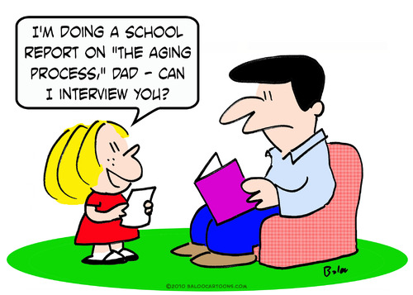
Empirical links
Aging 5 Years in 5 Minutes
Notes:
And, making age and aging the primary focus on intergenerational exchange, may run the risk of “backfiring” and fueling negative feelings about age.
FYI - You may have all heard of a recent study which found that older adults who were asked to take a brief memory test (we all associated with age) – made them feel old (and feeling older has been show by other research to have a range of personal implications).
Aging 5 Years in 5 Minutes: The Effect of Taking a Memory Test on Older Adults’ Subjective Age (2013, Psychological Science). Matthew L. Hughes, Lisa Geraci, Ross L. De Forrest

Slide 13

Talk of Ages
“Healthy Living and the Environment”
Notes:
In line with the “common group” – “no age” – “head fake” approach – I’ve introduced a new programming framework – “Talk of Ages” program which brings older and younger learners/adults around topics of “mutual interest”, outside of the typical age-related topics.
Last year, inspired by the 50th anniversary of Rachel Carson’s publication of Silent Spring -- and the popularity of our undergraduate environmental studies program and the interest of Lasell residents in social issues, we did a series of invited quest talks, class projects, films, book groups around “Healthy Living and the Environment”.

Slide 14
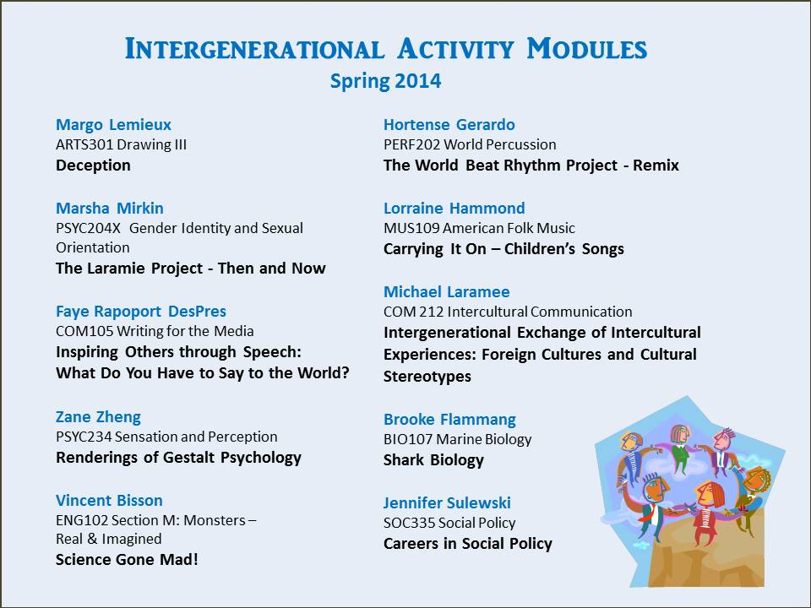
Talk of Ages
Notes:
This year, with the support of our office of Academic Affairs, I introduced a small grants program in which faculty develop intergenerational activities around some aspect of their course content. The modules take place over a “one week “ course period. Faculty received $250 for their time and effort in designing and implementing the modules. The module approach was taken in part to deal with instructors reluctance to “divert’” significant class time to “age-focused “ class work.

Slide 15
reflections
Lessons Learned
preparation
personal relations
adapting programs
collaborations
If you build it…
Remaining Questions
educational outcomes
personal impact
new formats
new contexts
Notes:
The last two years of “new age” programming have been very successful – with respect to rekindled interest in residents and faculty. And, I’ve been learning a lot about logistics!!
Preparation – lead time is needed to plan and sort our details – e.g., intergenerational activity program – faculty need to be given lead time to think about what they might do. Residents need to be given lead time to decide what activities they want to do
Personal relations -- And, for the module program many faculty don’t know what they might do, so I’ve needed to develop personal relations with individual faculty to be able to make suggestion about how they might include an intergenerational module in their class. The trick is to make is seamless, and make use of what faculty are already doing. The intergenerational piece should be seen as a gift /bonus not a task – it should be fun for everyone.
Adapting programs – At our opening ceremony Karen Buck talked about following “where the monkey throws the ball” – and, I’ve had to do a lot of this – especially figuring out how to
Collaborations – good programming is sometimes about “connecting the dots” – knowing what’s happening on other areas and looking for ways to join forces – e.g., in FYS classes – Girl Rising (educational journeys of young women around the globe).
Many questions also remain to be examined more systematically:
How does introducing this type of intergenerational exchange in the college classroom enhance students learning (need measures)?
How does intergenerational exchange impact older and younger adults age attitudes (my colleagues will address this in more detail)?
What new, “efficient”, “effective” formats can we develop within this framework?
Iin what new contexts can exchange occur – broader community settings, work settings, etc.?

Slide 16


w.i.s.e. - Working together: Intergenerational student/Senior Exchange
Carrie Andreoletti, Ph.D.
Department of Psychological Science
Central Connecticut State University
Jennifer Leszczynski, Ph.D.
Department of Psychology
Eastern Connecticut State University

Slide 17
Birth of w.i.s.e.
Working mission statement:
The mission of W.I.S.E. is to encourage young and older adults to build relationships by working together to identify common interests and goals for the purpose of dispelling age stereotypes, mutual lifelong learning, and community engagement.
Notes:
Idea was born after spending my sabbatical year (2011-2012) working with residents in two different independent living communities—I wanted a way for my students to have the same experience—goal was to combine my research interests with teaching and community engagement.
I was also inspired after my first AGHE meeting in 2012 (Arlington, VA) – I went to a poster session and talked with Melinda Baker from Ohio Wesleyan who had done what she called a collaborative exchange with her aging class and Joan Hatcher from Delaware Senior Citizens Inc, a senior center.

Slide 18
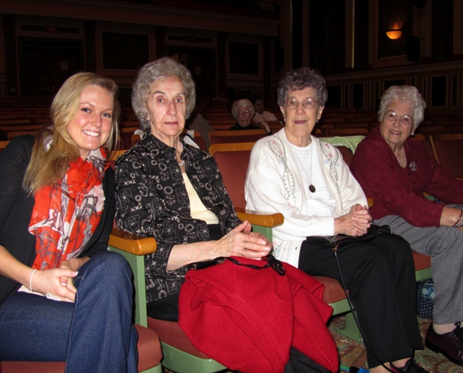
W.i.s.e - Fall 2012
Participants
6 students taking Adult Development and Aging
10 residents from The Orchards at Southington
Program
Get acquainted luncheon at The Orchards
“In My Shoes Exercise” – reverse role play
Movie day at CCSU “Mr. Smith Goes to Washington”
Impact of Technology
Love and Relationships
Notes:
This pilot program (funded by Community Foundation of Greater New Britain in collaboration with Central Connecticut Senior Health Services, Julie Norko) consisted of five sessions over the course of the semester. CCSU students taking Adult Development and Aging volunteered to participate as part of their class experience (the community engagement project replaced a research paper). Most sessions took place at the Orchards (Assisted Living Community), out side of class time (Friday at lunch). Sessions were two hours. Lunch was provided by the Orchards. Students and seniors worked together in small groups, which remained fairly consistent across the sessions.
We did not collect data but got feedback from students via reaction papers and from residents with a short post-program survey.

Slide 19
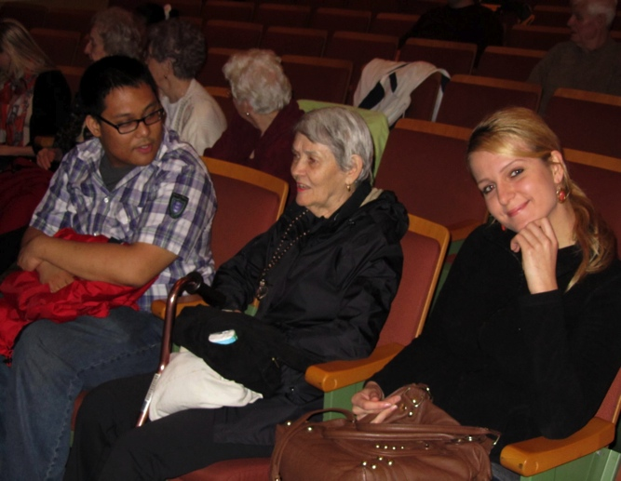
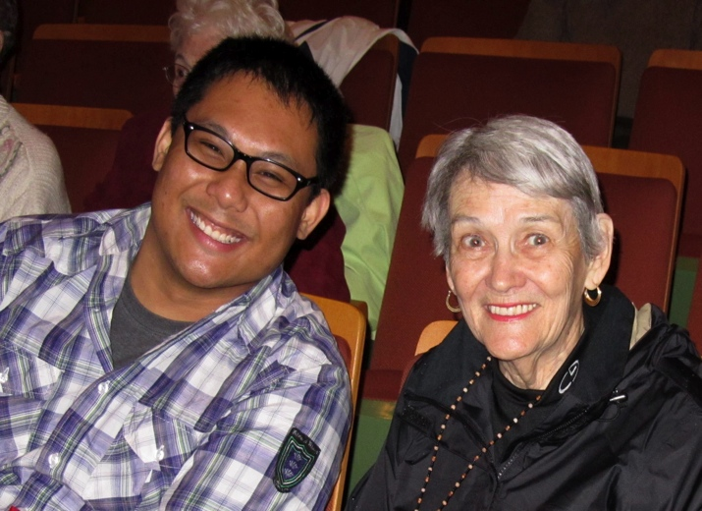
Selected comments from student papers
This experience has definitely influenced my likelihood of pursuing a career involving older adults.
After this experience, I find that aging can be beneficial despite the impairments, in which older adults can still engage is social activities and pursue their hobbies and interests.
Notes:
Another thing I learned is not to underestimate older adults. We shouldn’t treat them as fragile beings that can’t hold a conversation or not able to do anything until we really get a change to know them and know their limits if they have any.
I learned that we can’t just assume that because someone is “old” that they don’t any any of the same interest of us young adults.
My experience with WISE made me have a more positive view on aging and older adults.

Slide 20
Selected comments from residents
What were the strengths of the program?
The fact that young and old can meet and enjoy the experience. We laughed at some things they do and they came back with the same things about us – in a good way.
Understanding and bridging intergenerational differences
It opened up new discussions with different people
How did participating in this program influence your views of young people?
It strengthened my positive view of “there are so many young people that we don’t know about—and how they strive to be good citizens”
Trying to compare myself years ago to the young people. Outstanding young people.
Made me aware of all the very good ones – we see so much of the other kind.
Notes:
Overall, participants really enjoyed the opportunity to get to know one another and both young and old came away from the experience with a greater understanding of one another. The strengths of this pilot program were that it was an intimate group and so students and residents were really able to get to know one another. Lunch was served for all of the sessions at the Orchards and there was plenty of time for chatting. Sessions lasted about two hours.
Challenges
Meeting outside of class time and at the Orchards (off campus) was a huge challenge for my students. Transportation was a problem for several students. I had many more students who wanted to participate but timing and transportation proved to be a barrier.

Slide 21
w.i.s.e – spring 2013
Participants
30 students taking Adult Development and Aging
10-14 residents from The Orchards at Southington
Program
“Self Portraits” – Introductions at CCSU
Discussion of changes in Social Roles, Rules, and Expectations and Technology and Other Innovations
Students Visit The Orchards
Notes:
In an effort to increase student participation, we decided to conduct the majority of programs at CCSU during class time (thanks to Dr. Disch). Four sessions were planned, however one was cancelled due to inclement weather.
SESSION 1: Groups discussed: (1) Introductions - name, age, where from/raised, children/family, career/job/major; (2) Significant milestones and/or 3 proudest moments; and (3) What does it mean to achieve “optimal” old age?
SESSION 2: Groups discussed: (1) Social Roles, Rules, and Expectations Through the Years and (2) Technology and Other Innovations: Current vs. Past (we combined topics since we lost a session). For the last session, students visited the Orchards in small groups. They were asked to focus on successful aging; the do’s and don’ts, tips, and advice (but we not sure what exactly was covered—every visit was different!).

Slide 22
Research methods
Student measures:
Anxiety About Aging Scale (Lasher & Faulkender, 1993)
Fraboni Scale of Ageism (Fraboni, Saltstone, & Hughes, 1990)
Experience and interest living/working with older adults.
Resident measures:
Anxiety about Young People (modified subscale: Lasher & Faulkender, 1993)
Loyola Generativity Scale (McAdams & St. Aubin, 1992)
Depressive symptoms (CES-D; Radloff, 1977)
Notes:
Pre and post questionnaires were completed by students in class at the beginning and end of the semester and by the older participants at the assisted living community.
These are quantitative measures. Unfortunately we did not collect any qualitative data. I met with residents to get feedback but it was not an official focus group. Started to realize that a mixed methods approach is likely better for this type of research.

Slide 23
Preliminary Results – Students only
 | PRE-TEST | POST-TEST
 | M (SD) | M (SD)
Anxiety About Aging Scale | 48.68 (9.47) | 47.36 (8.11)
Fraboni Scale of Ageism | 64.36 (10.97) | 61.25 (9.79)
Antilocution Subscale* | 23.32 (5.80) | 20.64 (4.76)
To be presented at EPA, March 15, 2014, Boston, MA
Notes:
Poster to be presented at EPA next month. – Need to look more closely at some of the other measures.
Due to the small number of older participants who completed both the pre- and post-program surveys, only results for younger adults can be reported.
Changes in beliefs and anxiety about aging in the college students were measured with a paired-sample t-tests. Although there were no significant differences in the overall measures of ageism and anxiety about aging, means were in the expected
Examination of the subscales revealed a significant difference for the Antilocution subscale of the Fabroni Scale of Ageism, t (24) = 2.40, p <.02

Slide 24
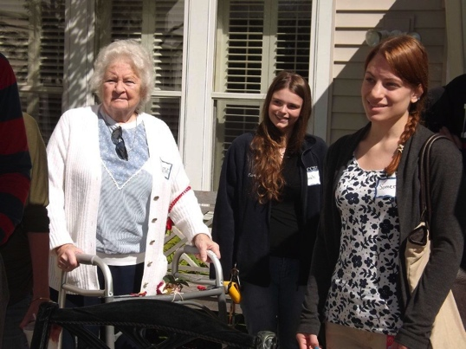
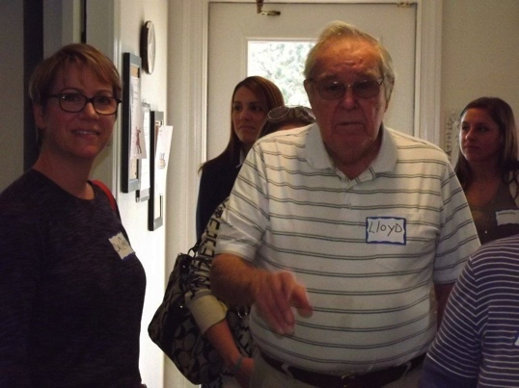
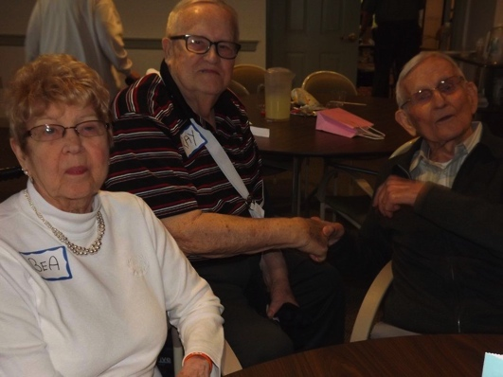
w.i.s.e. – fall 2013 CCSU PROGRAM
Participants
35 students taking Adult Development and Aging
10-14 residents from The Orchards at Southington
Program
“Speed Greeting” at The Orchards
Discussion of “Pressing Issues”
Brainstorming Projects and Community Building
Notes:
Would prefer more than 3 meetings but within the context of a semester long class this seems to work best. Made some changes based on last session. Moving focus away from age differences . . .

Slide 25
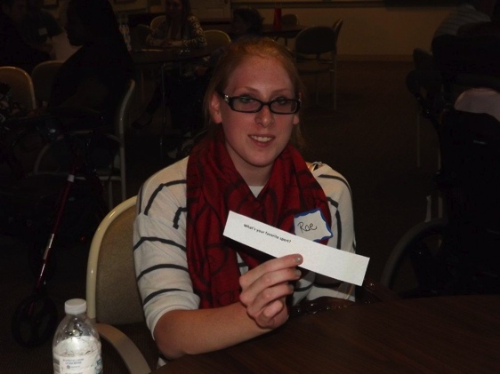
Speed greeting
Sample Questions
What is the greatest invention that has come along in your lifetime so far?
If you could go anywhere on a trip right now, where would you go?
What was one of the best gifts you have ever received?
Is there something you have always wanted to do that you have never done?
What do you know about your ancestors?
What was your first job?
What is your favorite holiday?
Where were you born?
What did you hate to eat as a child?
Are you a "morning" or "evening" person?
Notes:
Speed Greeting Exercise
Time needed = 45 minutes
Instructions: Organize students and residents into 8 groups of 5-7 people (4-5 students and 1-2 residents). Divide the questions below into 4 groups (5 questions each). Each table begins with the same set of 5 questions. Place questions in a bag and have a group member pull out one question at a time. Groups will have 10 minutes to answer the first set of questions (groups may or may not get to all questions). After 10 minutes, have students rotate to the next table and all tables get the next set of 5 questions. Follow this procedure two more times until 40 minutes are up and all 4 sets of questions have been distributed. You can end the session with a group discussion asking participants to share the most interesting or surprising things they learned about one another.

Slide 26
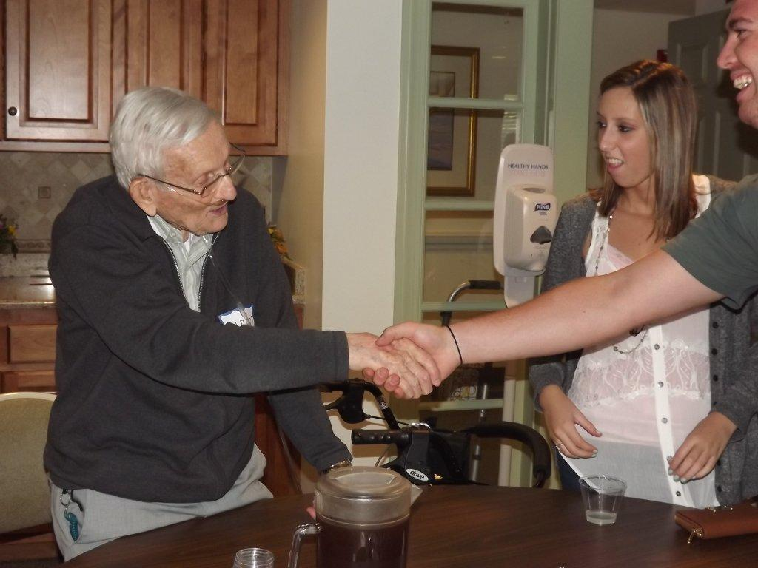
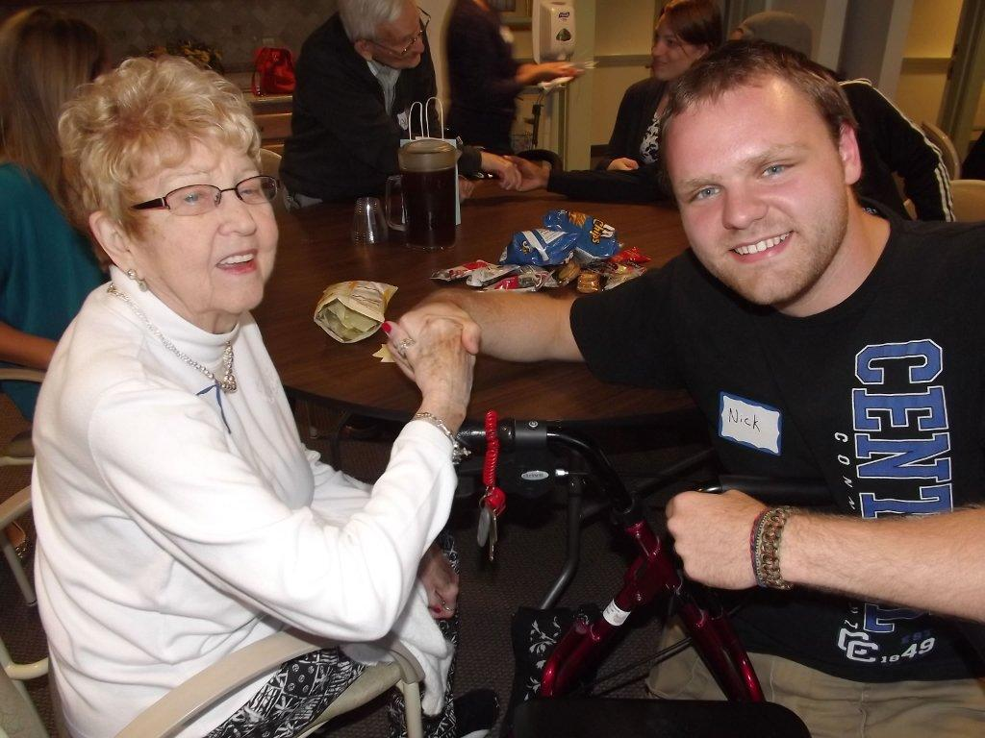
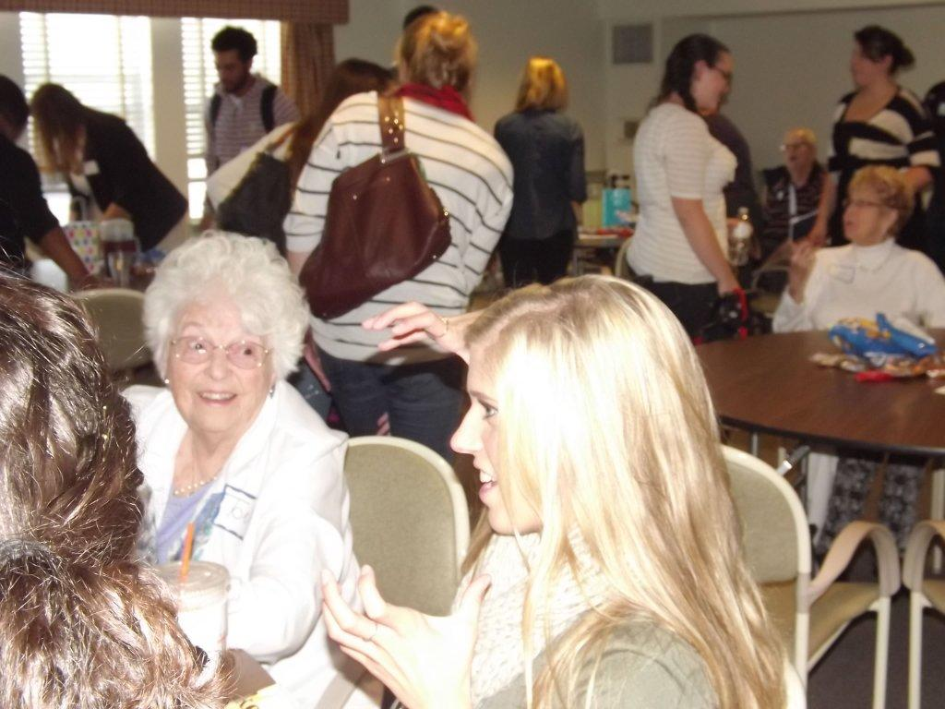
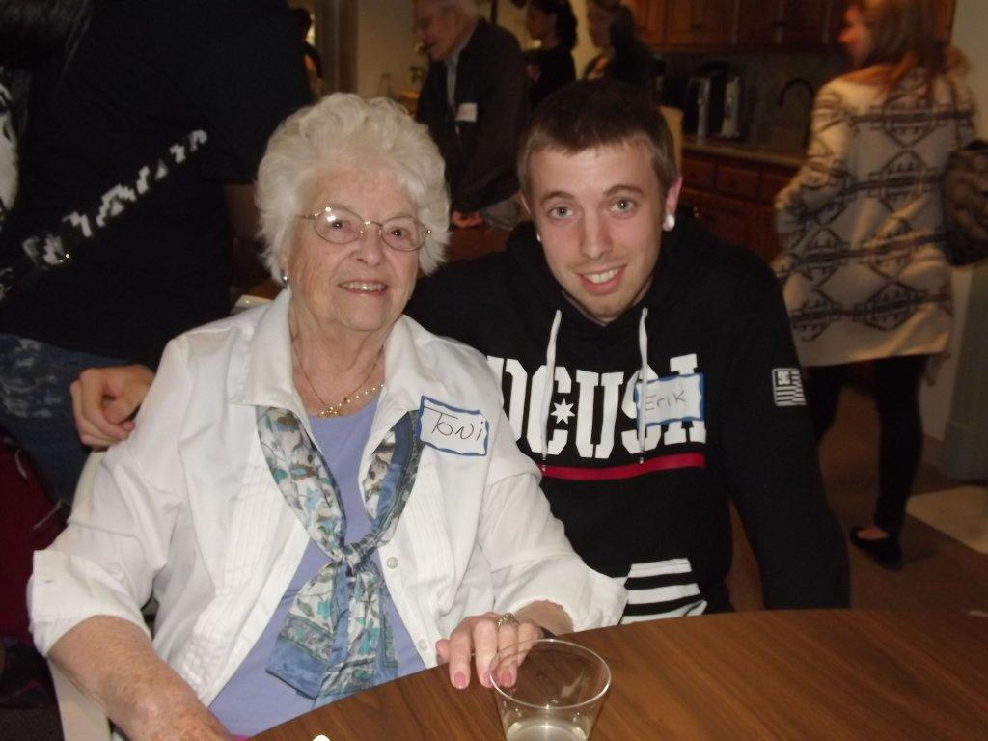
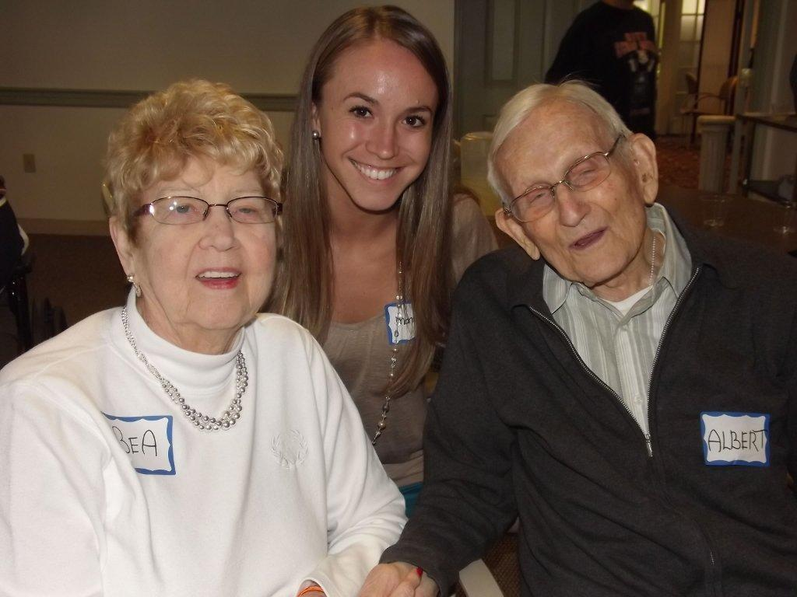
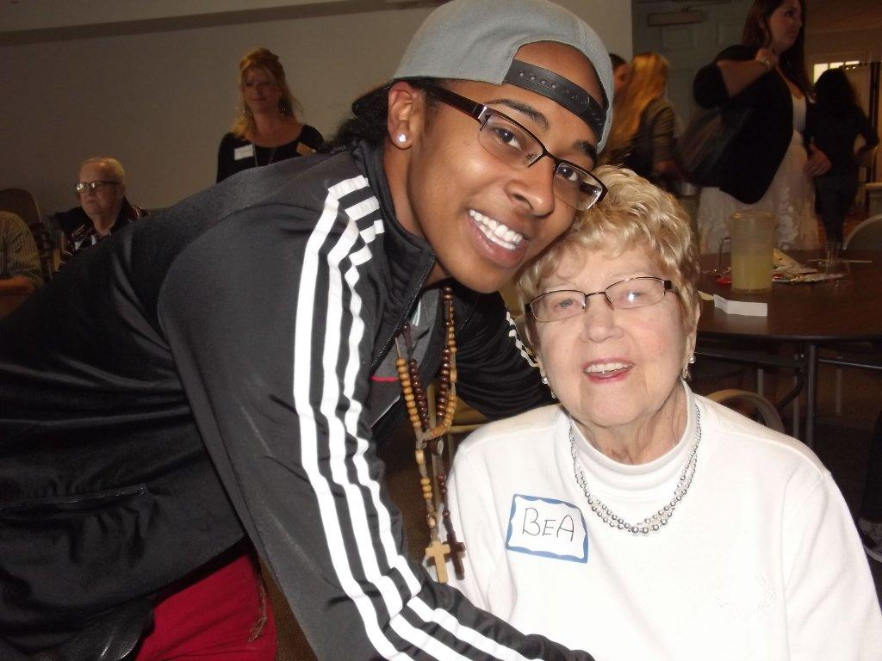
Notes:
Selected quotes from CCSU student reaction papers
WISE Fall 2013 – Session One – 9/18/13
Many of the seniors have experienced so much more in their lives than us, but it was ironic because in a way, they were not that different from us.
After this visit, I realize that there is hope and you could still live an exciting life when you are old.
It was awesome to hear about all of their lives and experiences they have had. I even found some similarities with some of the seniors and our favorite toys when we were younger.
One thing I took out of this experience is that being elderly does not mean you have to be miserable and sedentary.
Visiting the Orchards in Southington on Wednesday was on of the best experiences of my life. . .. I did not expect most of them to be so “with it.” I feel like a lot of people look at the elderly as all being the same, but they do not see how all of them are unique individuals part of that one big group.

Slide 27
W.I.S.E. What do you think are the three most pressing issues facing people today?
Notes:
Everyone provided their answers prior to the session and I summarized and handed this out to promote discussion. The focused on similarities and differences. Then they brainstormed ideas for how they might be able to work together to address some of these issues. Participants absolutely loved this exercise. It resulted in very lively discussions and residents wanted to discuss it further after the session so they organized another meeting at the Orchards!

Slide 28
W.i.s.e - Fall 2013 ECSU PROGRAM
Participants
12 students taking a Psychology of Adulthood & Aging class
Approx. 30 residents from St. Joseph’s Living Center
Program
“Speed Greeting” activity
Intergenerational discussion
Notes:
Carrie – I think that it makes sense for me to jump in here.
Through a wonderful moment of serendipity, I became involved with Carrie’s program. I was looking to integrate a community engagement piece into my Psychology of Adulthood & Aging class and happened to mention it to Carrie in our discussions about this symposium. She generously shared the WISE program and what she had learned in her time piloting the program – we thought that this was a great opportunity to see if the program would work in a different setting.
St. Joseph’s Living Center seems to be very different from the Orchards – there are both short-term and long-term residents there. Even though I explained to the recreation director that I wanted participants who did not have any cognitive difficulties, it ended up being whoever showed up that day – because of this we had a few seniors who were extremely engaging and wonderful with the students – we also had a few seniors who have significant difficulties carrying on a conversation. There are both positive and negative aspects of this – can discuss at the end. Our Center for Community Engagement organized transportation to St. Joseph’s and the program took place in their Recreation Room. The first session was exactly what Carrie used at the Orchards with 1-2 students at each table with 4-5 seniors

Slide 29
W.i.s.e - Fall 2013 ECSU PROGRAM
Intergenerational Discussion
What advice would you give people younger than yourself?
What invention has had the greatest impact on your life?
How has how people communicate changed throughout your lifetime? Are you familiar with Facebook, texting etc.?
If you had to select one event in history that defined your generation, what would it be and why?
If you went out with friends as a teenager/young adult, where did you go and what did you do?
What about gender equality on a date?
Notes:
For the second session, as an entire class, we brainstormed some questions to include in an Intergenerataional Discussion. Students liked being able to speak to multiple residents, so I divided the questions up by group and they moved around 3 different times.
Many of my students actually reported that it was nice to have the questions available to spark discussion – but that one question usually was enough to lead to a longer discussion on each of their lives. In talking to students, my feeling is that this highlighted their similarities more than their generational differences!

Slide 30
Research methods
Student Measures (CCSU/ECSU pre- and post-program):
Anxiety About Aging Scale (Lasher & Faulkender, 1993)
Fraboni Scale of Ageism (Fraboni, Saltstone, & Hughes, 1990)
Experience and interest working with older adults.
Qualitative questions
Resident Measures (CCSU post-program only):
Anxiety about Young People (modified subscale: Lasher & Faulkender, 1993)
Loyola Generativity Scale (McAdams & St. Aubin, 1992)
Qualitative questions
Notes:
The same quantitative measures as before but this time we added some open-ended questions.
How did participating in this program influence your views of younger/older adults?
What did you get out of participating in the WISE program
What are the strengths of the program?
How can the program be improved? Do you have any suggestions for future programs?
Is there anything else you would like to share with us?
We have yet to analyze the quantitative data or systematically analyze the qualitative data, but we will share some of the comments from the open-ended questions.
Students filled out the questionnaires in class and residents were interviewed – RA or activities director met with them one-on-one to complete the survey (past attempts to do this in a group format were challenging)

Slide 31
Ccsu Students – Fall 2013
How did participating in this program influence your views of older adults?
I became more respectful of older adults.
It helped me become more understanding of their opinions, feelings and attitudes . . .
This program made me feel more comfortable around older adults.
I found that each older adult has their own unique characteristics and were full of joy. That I should look forward to aging.
The program gave me a better understanding of what the elderly go through on a daily basis.
It made me see that many of them are still happy and have active lifestyles. Growing old doesn’t mean one has to be isolated.
Notes:
Jenn – do you want to add comments from your students? Feel free to delete some of mine.

Slide 32
Ccsu Students – fall 2013
What did you get out of participating in the W.I.S.E. program?
The older and younger people have a lot in common.
They are a lot more interesting than they appear.
Old age doesn’t have to be a negative part of our lives.
I learned how great it is to form connections with older adults.
I gained a deeper interest in socialization and working with older adults.
I am now very interested in working with the elderly.
I found it interesting and nice to get to know some of the residents, and hear how they felt about hot button issues.

Slide 33
Orchards Residents – Fall 2013
How did your participation in this program influence your views of younger adults?
I was thrilled to talk to the students. Sometimes people say bad things about youth but that is a misconception.
Improved it, gives me hope that the world won’t collapse. Have a lot in common, very polite and thoughtful.
Very decent, was expecting flighty. Very educated and ambitious. Interested in what they’re doing.
Very positively. Terrific impression, they were introspective, intelligent, polite.
I think they’re terrific. More mature than I as at that age. Most work and go to school.
Notes:
Unfortunately we did not ask the corresponding question to the younger participants
Small sample—only 11 responses – older participants who were teachers did not feel that it influenced them that much

Slide 34
Orchards Residents – fall 2013
What did you get out of participating in W.I.S.E. program?
Realize how intelligent young people are today.
Gave me a big lift, a lot of hope for the world, important to know what each other is thinking.
Satisfaction of knowing young people. Find out teens are the same as in the 50s, impressed by intelligence, honesty, politeness.
Different view of young people.
So much a like, time flew by.
Happy feeling because I am a talker. Kept me going and slowed them down.
Notes:
One person said – not very much. The program is not a good fit for everyone.

Slide 35
Orchards Residents – fall 2013
Strengths
Gives you a chance to express your opinion. Gives you a chance to think.
Linking the generations. Learning the differences and similarities between seniors and youth.
The rapport, went smoothly, everyone had something to say.
Elderly and young together. Ideas about changes that have happened.
How can the program be improved?
Smaller groups, hearing was a problem, students need to talk slower, more comfortable having sessions at the Orchards.
Walking distance, bathrooms.
Notes:
Maybe we don’t need this slide – this issues will come up in our discussion of lessons learned.

Slide 36
Lessons learned and ongoing challenges
What Works
Smaller groups
Structured activities that involve rotating groups
Meeting during class time
Challenges
Transportation
Location
Keeping content fresh for continuing participants
Tailoring content specifically for your group
Getting older adults to consistently participate
Notes:
Can we do this together or perhaps alternate? Your challenges were different. Not sure what to put on this slide.
What works:
Small groups work best
Structured activities that involve rotating groups so there is an opportunity to interact with more people
Meeting during class time allows more students to participate
However, if it is off-campus, this was a challenge because students have classes before and after the session. Even though transportation was provided at Eastern, many students could not go because they would miss the end or beginning of another class.
Ongoing challenges:
Transportation
You have to have some support from your campus if you are going to the facility – this was not a challenge at Eastern’s site.
The Orchards sent a van to and from campus for 12 students max – this was great for students without cars!
Location – it is good to go to both places, but fewer residents participate when sessions are on campus – hard to get students off campus
The most common comment that students made at Eastern was that they wished we had gone to a senior center instead of a nursing home.
Orchards residents complained of too much walking when they came to campus, bathrooms not great, hard to hear is some rooms
How to keep program content fresh for residents
Tailoring content specifically for your group is usually needed
Getting a large enough group of older adults to consistently participate for research purposes
St. Joseph’s Living Center did not allow us to collect data from residents after the program

Slide 37
Where do we go from here?
Future of W.I.S.E.
Take it outside the classroom
More project driven
Involve a broader range of older adults
Create a “package” that can be used at other institutions based on what we have learned
Create an intergenerational club?

Slide 38
Acknowledgements
Funding:
Community Foundation of Greater New Britain, Eastern Connecticut State University Center for Community Engagement Faculty Fellowship Award
Collaborators:
Central Connecticut Senior Health Services
The Orchards at Southington, Southington, CT
Saint Joseph’s Assisted Living Center, Willimantic, CT
Michelle Korby-Gale, Activities Director, The Orchards
Jessica Howard, Research Assistant, CCSU
Eric Cerino, Research Assistant, ECSU
Bill Disch, Ph.D., CCSU
Joann M. Montepare, Ph.D., Lasell College
Notes:
Put this at the end?
Yes – I think that this belongs at the end. I added in my funding source and helpers too!

Slide 39

Linking Undergraduate Students with Grandfamilies to Support Intergenerational Relationships
Christine A. Fruhauf, Ph.D.
Associate Professor and Director, HDFS Extension
Coordinator, Gerontology Interdisciplinary Minor – Sponsored by: Columbine Health Systems
Colorado State University
Paper Presentation at the 40th Annual Meeting & Educational Leadership Conference of the Association for Gerontology in Higher Education
March 2, 2014 – Denver, CO

Slide 40
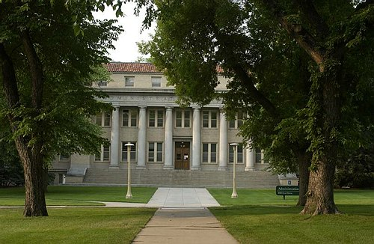
Colorado State University
Research, Education, Service, Extension

Slide 41
Background
Gerontology at CSU:
College of Health & Human Sciences; Department of Human Development and Family Studies
Undergraduate Certificate Program in Gerontology (Est. 1981)
Changed to an Interdisciplinary Minor in 2009
Official sponsorship from Columbine Health Systems (2009)

Slide 42
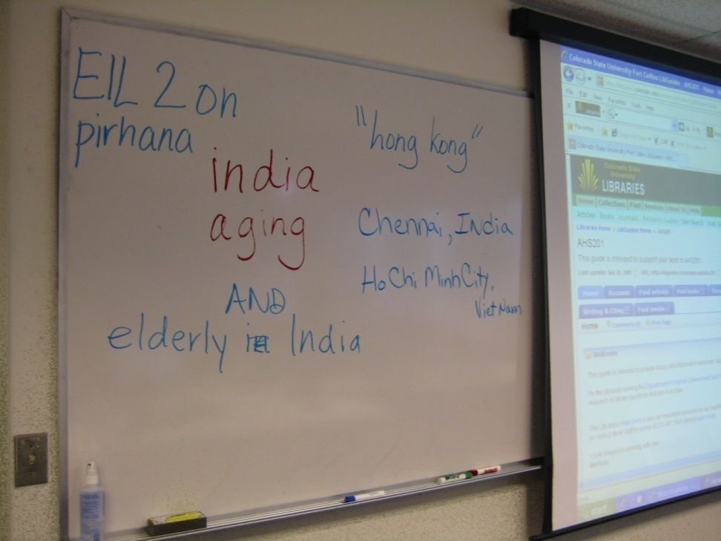
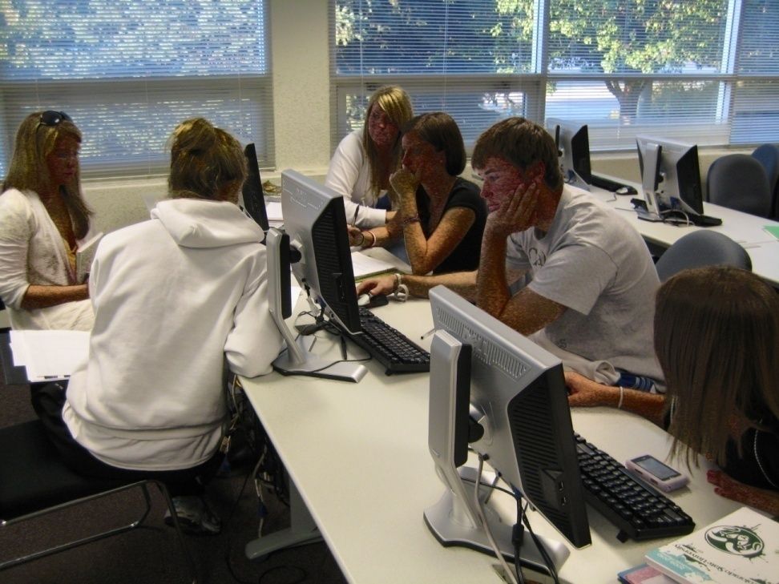
Engaging Undergraduate Students
With Older Adults
Notes:
Recognize the importance of engagement of students with older adults. Yet, we need to continue to think about it differently than say we have in the past. For example, because CSU focuses on engagement with the community, how can I as an instructor link undergraduate gerontology minor students to older adults in the community? One way I have been able to do this is by building into the student program of study are service-learning opportunities.

Slide 43
Course Work
AHS 201: Perspectives in Gerontology
3 credit course
Meets once a week for 3 hours
Focus on contemporary topics in aging research; career exploration; and service-learning with older adults
Notes:
For example, a core course that is required of students in the Minor is AHS 201: Perspectives in gerontology. Talk about the course here – highlighting the S-L assignment.

Slide 44
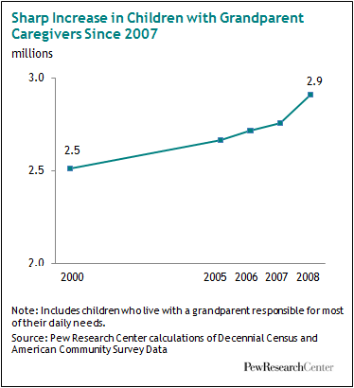
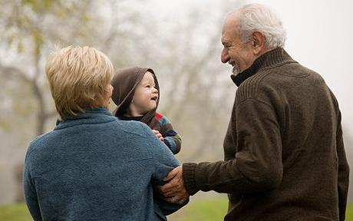
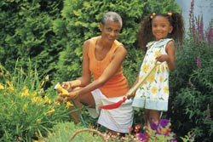
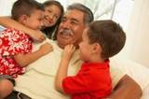
Who and Why Grandfamilies?
Notes:
One of the areas students can focus their service-learning experience is with working with grandfamilies. First, what is grandfamilies – go into defining this and giving statistics including Colorado numbers.

Slide 45
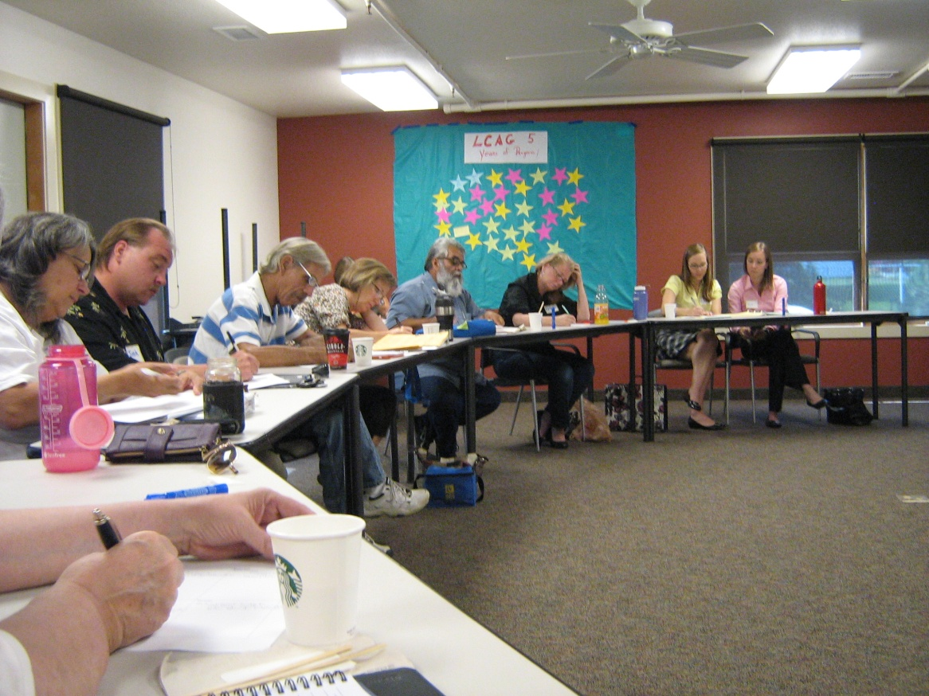
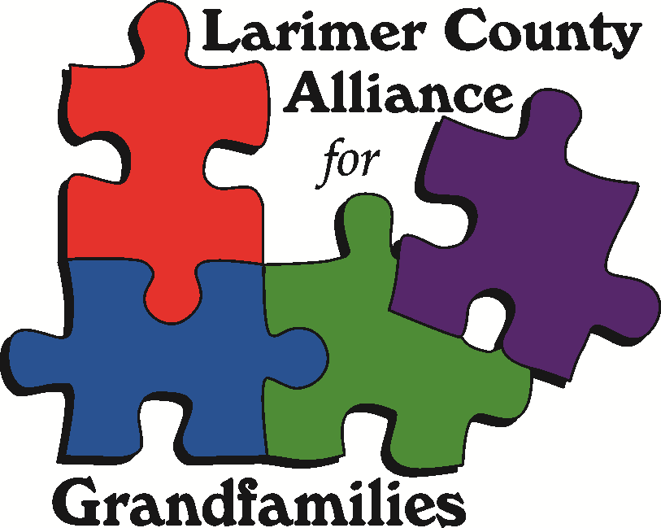
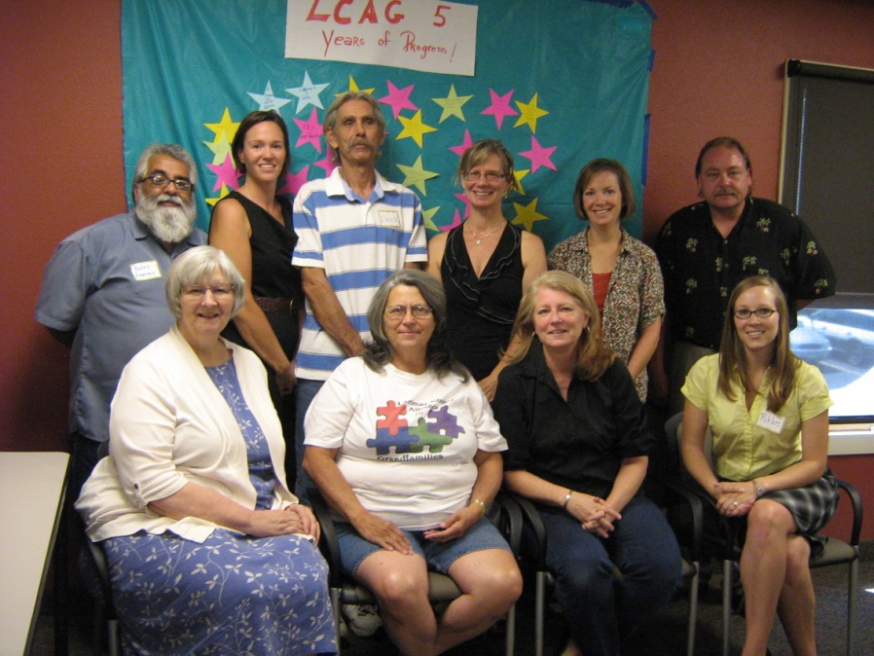
Community Connections & Partners
Notes:
Again, linking the University’s mission to our student learning and to community engagement – one service-learning activity that student can participate in is through the Larimer County Alliance for Grandfamilies. Here give details on the Alliance, its mission, partners, history, etc.

Slide 46
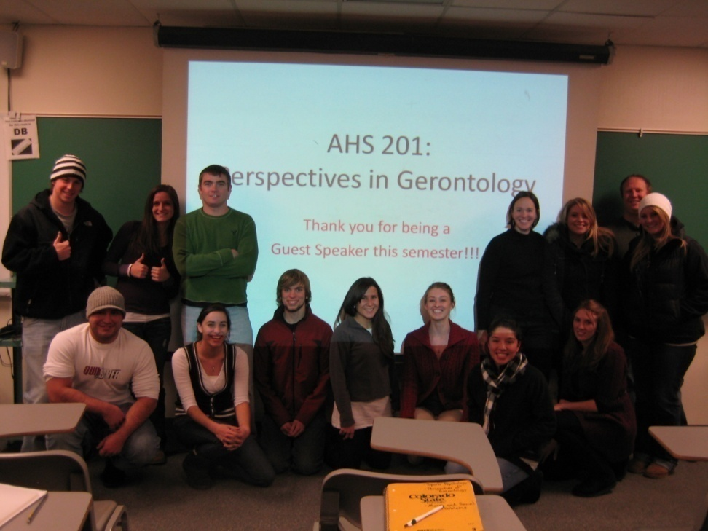
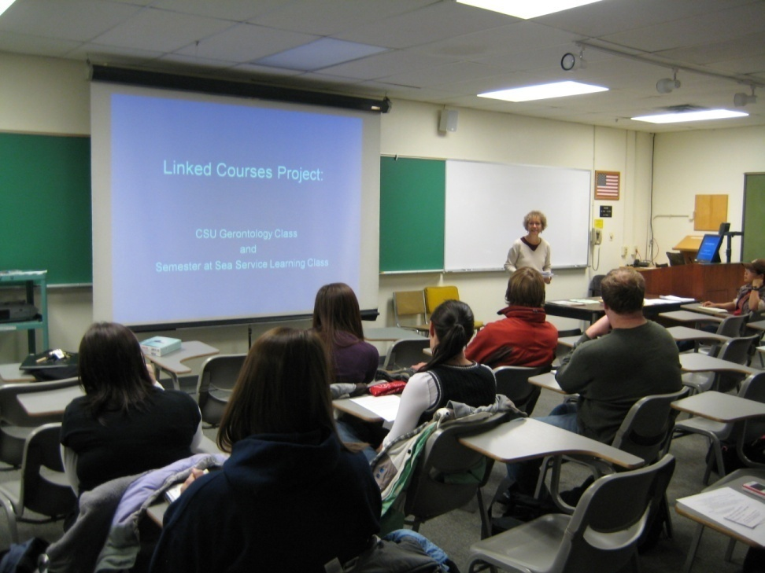
Educational Activities
Notes:
Next, here are examples of activities that students in the past have done for their service-learning activities that link them to older adults without placing the emphasis on “older or younger” and instead places it in the context of a type of family form and in community engagement. These allow for greater understanding of working in places of work with multi-generations.
Attend meetings, take notes, participate in support groups – providing childcare to the grandchildren (another example of IG), interviewing grandparents and writing articles for out website, etc.

Slide 47

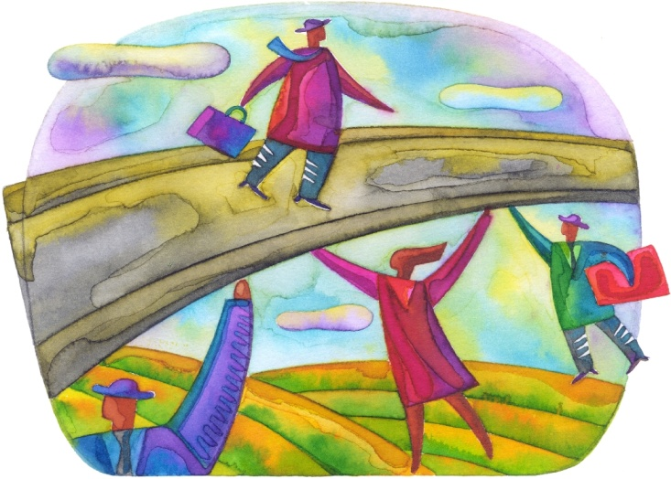
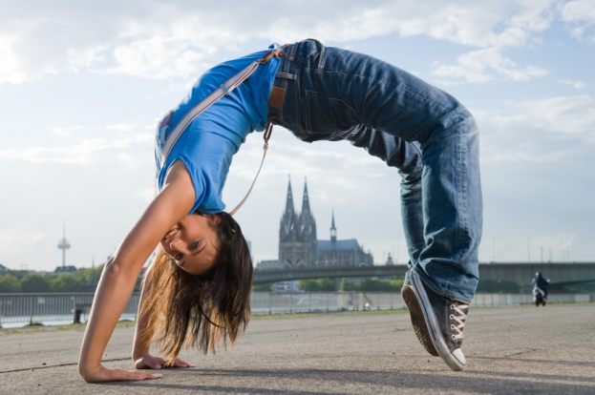

Relationship Building
Community Support
Insights & Challenges
Flexibility
Risks & Liability
Road Blocks
Time
Notes:
Address these topis.

Slide 48






Acknowledgements
Funding Sources:
Collaborators:
Ann Bruce, Ph.D., & Kim Bundy-Fazioli, Ph.D., Colorado State University
Larimer County Grandparents
Larimer County Alliance for Grandfamily Partners & Affiliates

Slide 49
Questions & Comments
Linking Undergraduate Students with Grandfamilies to
Support Intergenerational Relationships
Christine A. Fruhauf, Ph.D.
Associate Professor and Director, HDFS Extension
Coordinator, Gerontology Interdisciplinary Minor
Colorado State University
Paper Presentation at the 40th Annual Meeting & Educational Leadership Conference of the Association for Gerontology in Higher Education
March 2, 2014 – Denver, CO

